Slide 1

FRAUD DETECTION
Group 2

Slide 2
Table of contents
Case
Methodology: Isolation Forest
Feature selection
Results

Slide 3
Case on Fraud detection
Fraud detection based on unsupervised learning
Task is to output 100 most suspicious transactions
Data consists of 280k+ data points, and 30 features

Slide 4
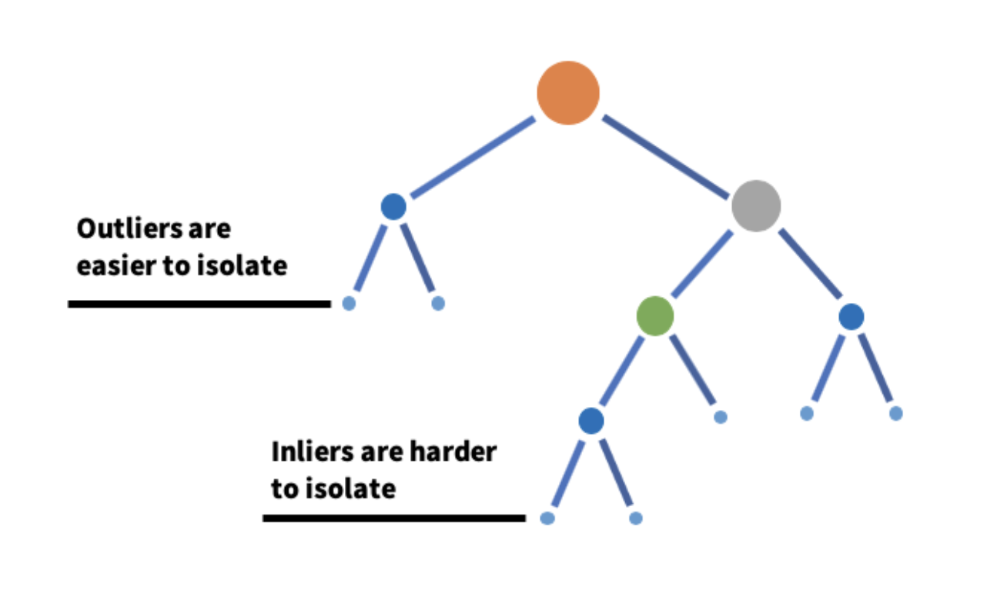
Isolation Forest

Slide 5
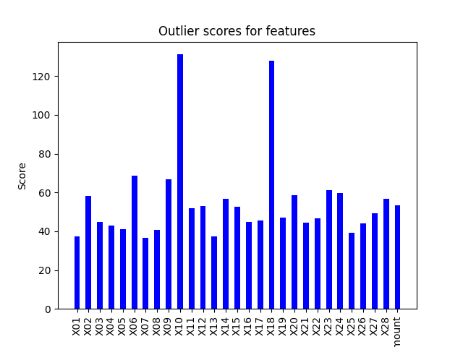
Feature selection

Slide 6
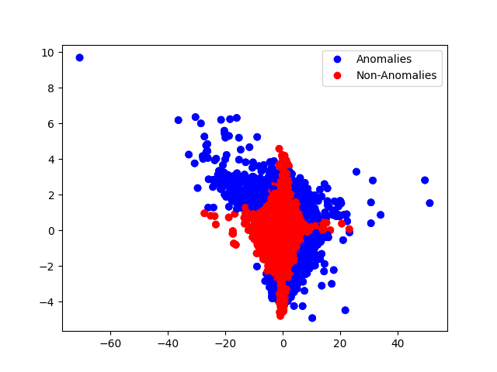
Predicted anomalies

